Slide 1
Computer Vision (CV)
[RCNN Family]

Slide 2
R-CNN for object detection
• Scan the input image for possible objects using an algorithm called Selective Search, enerating ~2000 region proposals.
• Run a convolutional neural net (CNN) on top of each of these region proposals.
• Take the output of each CNN and feed it into
SVM to classify the region
Linear regressor to tighten the bounding box of the object if such an object exists.

Slide 3
R-CNN Architecture

Slide 4
Fast R-CNN
• The purpose of the Fast Region-based Convolutional Network (Fast R-CNN) is to reduce the time consumption related to the high number of models necessary to analyze all region proposals.
• Performing feature extraction over the image before proposing regions, thus only running one CNN over the entire image instead of 2000 CNN’s over 2000 overlapping regions.
• Replacing the SVM with a softmax layer, thus extending the neural network for predictions instead of creating a new model.

Slide 5
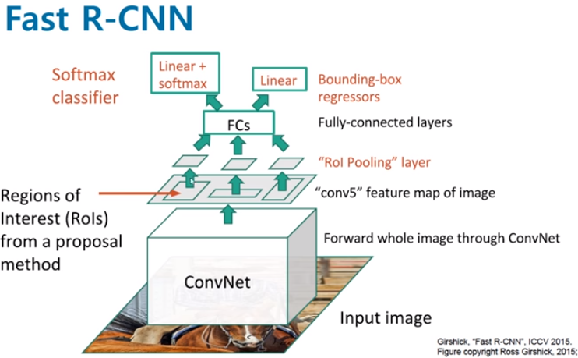
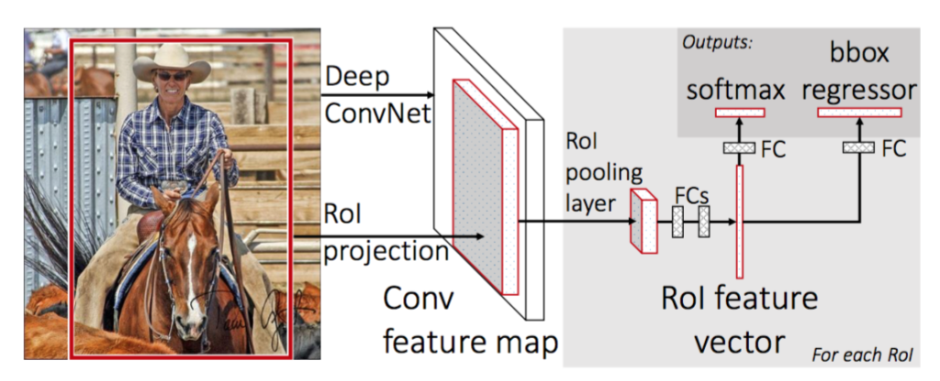
Fast R-CNN Architecture

Slide 6
Faster R-CNN
• Step 1: Feature Extraction
The input image is passed through a pre-trained CNN backbone (the original Faster R-CNN used VGG).
The network extracts a convolutional feature map, which is then used for subsequent processing.
• Step 2: Region Proposal Network (RPN)
The RPN takes the feature map and proposes a set of candidate regions (bounding boxes) that may contain objects.
It does this by generating multiple region proposals using k anchor boxes of predefined scales and aspect ratios.
k anchor boxes = the number of predefined bounding box shapes (scales + ratios) that the network uses at each feature map location to generate region proposals.
Each anchor = one rectangle shape.
You choose different scales (small, medium, large)And different aspect ratios (e.g., 1:1, 2:1, 1:2) This module significantly speeds up both training and inference compared to earlier methods.
• Step 3: R-CNN Module
For each proposed region, the R-CNN head performs two tasks:
Classification – Determine what object (if any) is inside the region, including the “background” category.
Bounding Box Regression – Refine the bounding box coordinates to better align with the detected object.

Slide 7
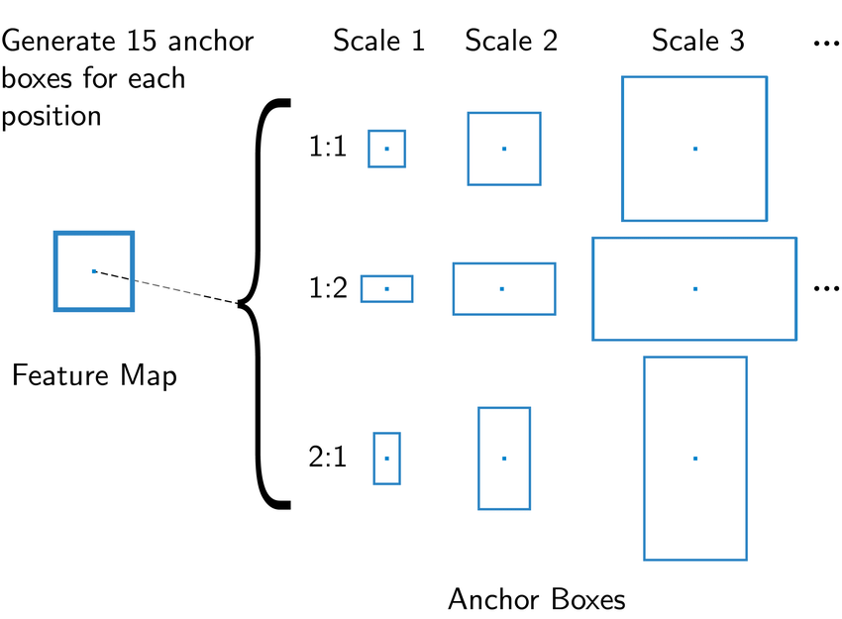
illustration

Slide 8
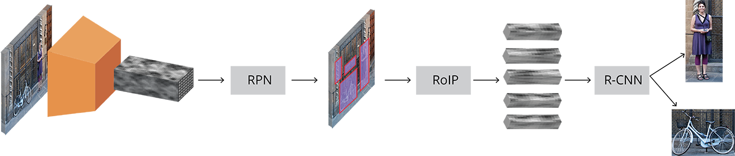
Faster R-CNN Architecture
It starts with an input image that is passed through a convolutional backbone to extract deep feature maps. These feature maps are sent to an RPN (Region Proposal Network), which generates candidate object regions (shown as red boxes).
Then, the RoI Pooling (RoIP) layer extracts fixed-size feature vectors from each proposed region. Finally, these region features are passed to the R-CNN classifier, which identifies the object in each region and refines the bounding box.

Slide 9
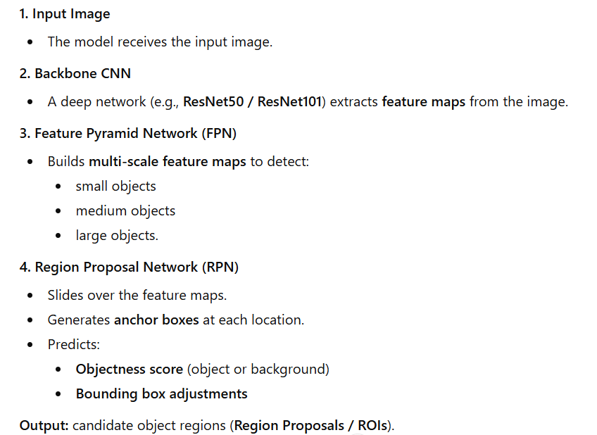
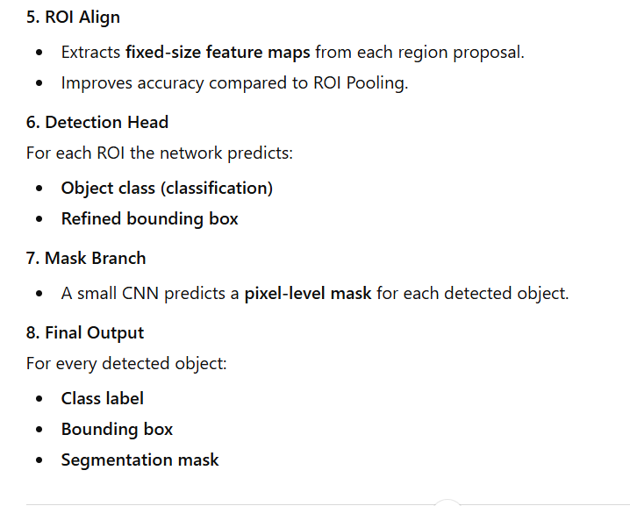
Steps of Mask RCNN

Slide 10
Mask R-CNN Architecture

Slide 11
Detectron2
• Detectron2 was built by Facebook AI Research (FAIR) to support rapid implementation and evaluation of novel computer vision research.
• Detectron2 is now implemented in PyTorch.
• Detectron2 is flexible and extensible, and able to provide fast training on single or multiple GPU servers.
• Detectron2 can be used as a library to support different projects on top of it.

Slide 12
Detectron2 Model Zoo
Detectron2 Model Zoo : https://github.com/facebookresearch/detectron2/blob/master/MODEL_ZOO.md

Slide 13
Detectron2 - Inference

Slide 14
Train Detectron2 On A Custom Dataset
Convert your data-set to COCO-format
The COCO dataset is formatted in JSON and has five annotation types: object detection, keypoint detection, stuff segmentation, panoptic segmentation, and image captioning. It is a collection of “info”, “licenses”, “images”, “annotations”, “categories” (in most cases), and “segment info” (in one case).

Slide 15
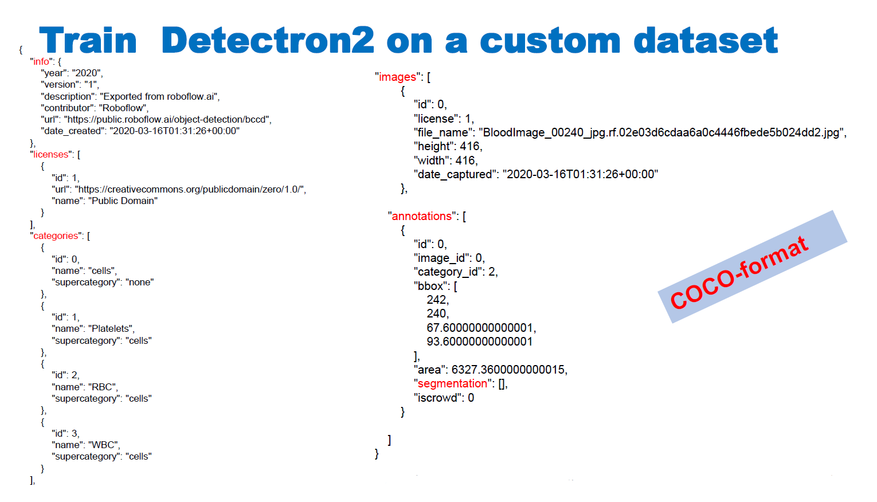

Slide 16
Train Detectron2 On A Custom Dataset

Slide 17
Train Detectron2 On A Custom Dataset
• Detectron2 keeps track of a list of available datasets in a registry, so we must register our custom data with Detectron2 so it can be invoked for training.
# Register Custom Detectron2 Data
from detectron2.data.datasets import register_coco_instances
register_coco_instances("my_dataset_train", {}, "/content/my_dataset/train/_annotations.coco.json",
"/content/my_dataset/train")
register_coco_instances("my_dataset_val", {}, "/content/my_dataset/valid/_annotations.coco.json",
"/content/my_dataset/valid")
register_coco_instances("my_dataset_test", {}, "/content/my_dataset/test/_annotations.coco.json",
"/content/my_dataset/test")

Slide 18
Train Detectron2 On A Custom Dataset
• Detectron2 keeps track of a list of available datasets in a registry, so we must register our custom data with Detectron2 so it can be invoked for training.
# Register Custom Detectron2 Data
from detectron2.data.datasets import register_coco_instances
register_coco_instances("my_dataset_train", {}, "/content/my_dataset/train/_annotations.coco.json",
"/content/my_dataset/train")
register_coco_instances("my_dataset_val", {}, "/content/my_dataset/valid/_annotations.coco.json",
"/content/my_dataset/valid")
register_coco_instances("my_dataset_test", {}, "/content/my_dataset/test/_annotations.coco.json",
"/content/my_dataset/test")

Slide 19
Thanks for listening

